Slide 1

Buy U a Drink… Business
Matthew Barger

Slide 2

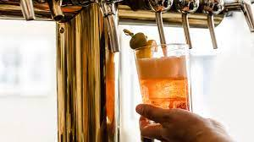
‘Tap’ping Into The Data
Iowa Department of Commerce publushes log of all Class-E liquor sales in Iowa as open data
Dataset has 12.5 million entries over 58 months
Data is very thorough, with 26 categories including item description, liquor type, cost from vendor, retail price, store location, and item number
10,000s of missing values

Slide 3
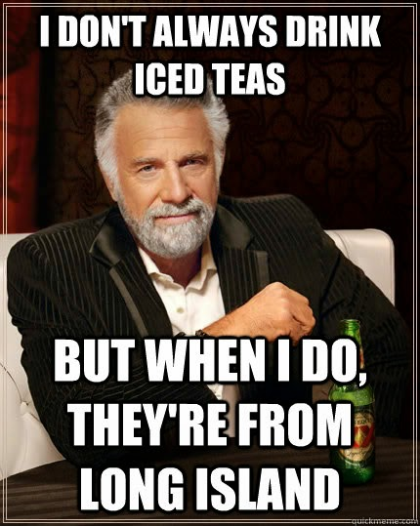
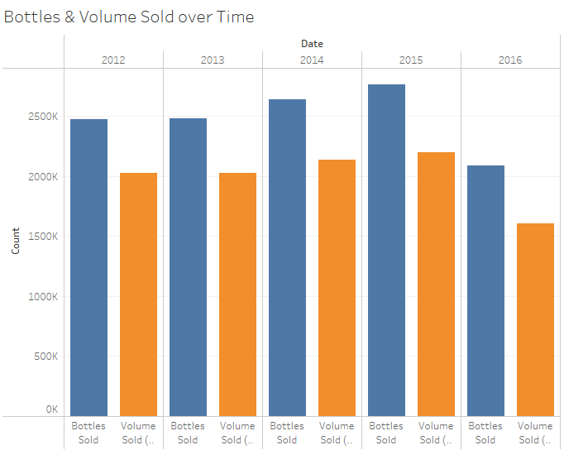
Cock’tale’ of the Numbers

Slide 4
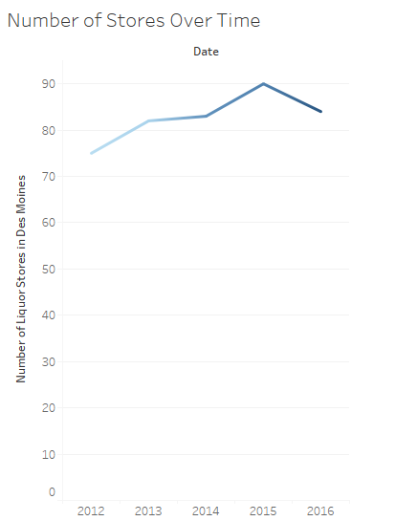
Cock’tale’ of the Numbers (Cont.)

Slide 5

My Focus
Due to the extent of the data available, my goal is to determine material costs for liquor for someone opening a liquor store in Iowa
Scope of data is limited to Des Moines, Iowa
Focuses on a single city to keep consistency in the data
Retains over 500,000 entries for depth of information to model after

Slide 6

Struggles/Strategy
Due to the nature of looking at material costs, several categorical factors appear relevant in the modeling process, which can quickly derail the accuracy of any machine learning model if there are too many unique elements when encoding them.
Upon further research, it appeared there was a lot of overlapping influence between these categories (such as Vendor Number, Item Number, Item Description, State Bottle Cost). To represent this relationship I chose ‘Item Number’ as the most independent variable of the group to use for developing a model

Slide 7
Struggles/Strategy (Cont.)
Another obstacle was cleaning 10,000s of missing elements
Initially, manual substitution sufficed for columns such as ‘County’ and ‘County Number’ where only 2 unique values were missing
However, especially in years 2015-2017, there were dozens of unique values for Category, Category Number, Store Number, and address-related elements that deemed manual substitution inefficient
I combatted this by concatenating all years of the relevant columns (2 or 3 each) and compiling dictionaries for all cases where a nan-value of a column with a 1:1 ratio to another column (ie ‘County’ & ‘County Number’) had a unique value elsewhere in the data. These dictionaries were then applied across all data
Dictionaries saved as csvs
Saved in functions for easy reapplication
Minimal manual substitution was still necessary in ‘Category’ and ‘Category Number’

Slide 8
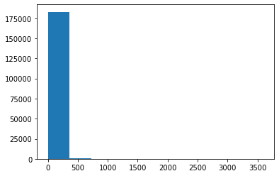
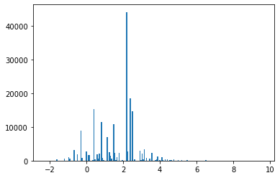
Prepping Data
Item Number, Store Number, and Volume Sold (L) were my variables to find my target ‘Total Cost’
Volume Sold (L) had a log transformation that greatly reduced the number of variables outside the upper limit
BEFORE AFTER

Slide 9
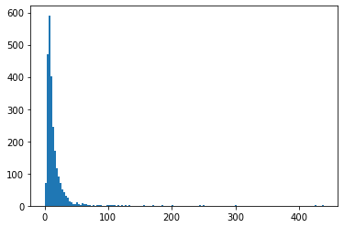
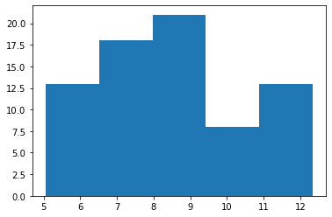




Prepping Data (Cont.)
Using aggregation by the mean cost per sale, Item Number and Store Number were similarly analyzed to categorize into 4 and 5 part, respectively.

Slide 10

Results/Conclusion
Machine learning model best results:
Linear Regression 3.1860% (with log transformation)
Kneighbors 3.7109% (3 n_neighbors)
Random Forest Regressor 4.2667% (100 n_estimators)
Machine learning model conclusion:
Clearly the variables chosen do not have strong correlations with total cost
This is either due to a very poor choice in x_data or the inability of data to account for human randomness in pricing

Slide 11
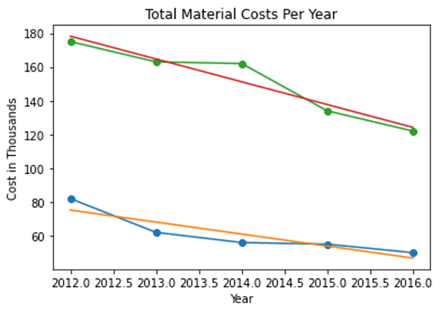
Results (Cont.)
Slope-Intercept function shows a continuous decline in costs which is also directly proportional to declining sales
No immediate cause for this was clear, as the number of stores remained relatively steady over the 6-year period, though an increasing gap between vendor costs and retail value was also noticed
Plot Legend:
Green line represents 75th percentile of costs
Blue lines represents median costs

Slide 12

Until Next Time…
Given another go at this data, I would ask a different question since my first one did not yield effect results. I believe the data could reveal information for some questions that would not be as intuitive as it seemed
"How does local population count affect sales"
“When are the slowest months for liquor sales in Iowa“
To be more efficiently handle the data:
Cut columns for my specific goals earlier in the process
Outliers could be cut earlier
Strategies I would keep:
The use of dictionaries, functions, and maps were highly effective
Strategies I could use:
DBscan pricing of types of liquor
Categorical approaches

Slide 13





‘Drinks’ for Coming!

